Slide 1

DEPARTMENT OF COMPUTER SCIENCE AND ENGINEERING
INTERDISCIPLINARY PROJECT
Poll-System
PROJECT STUDENT
N L Varshita Reddy
(Reg-43110536)

Slide 2
ABSTRACT
PollSystem is a web-based interactive polling application developed using React.js, Python Flask, and MySQL, with Firebase Authentication for secure, role-based access. It enables teachers to create and manage live classroom polls while allowing students to participate easily and view real-time results through Chart.js visualizations
Designed following Human-Computer Interaction (HCI) principles, the system focuses on simplicity, usability, and responsiveness. Usability testing and surveys revealed that users found it intuitive and efficient, enhancing classroom engagement, active learning, and instant feedback between teachers and students..

Slide 3
EXISTING SYSYTEM
In traditional classrooms, student participation is often minimal, with teachers relying on verbal questioning or manual surveys. Existing poll tools like Mentimeter or Kahoot may provide interactivity but often require paid subscriptions, high-speed internet, or complex setup, limiting their accessibility in educational institutions with budget or resource constraints.
Most existing polling systems have complex interfaces, restricted customization, and limited device compatibility. They may not fully adhere to Human-Computer Interaction (HCI) principles such as simplicity, accessibility, and responsive design, leading to usability challenges for both teachers and students. Additionally, real-time result visualization and secure role-based access are not always well-integrated in these tools.

Slide 4
PROPOSED SYSTEM
The proposed PollSystem introduces a simple, responsive, and accessible web-based application that enhances classroom engagement through live polls. It allows teachers to create, edit, and monitor polls via an intuitive dashboard, while students can easily participate and view results in real time through interactive Chart.js visualizations.
Built using Python Flask, React.js, and MySQL, the system ensures secure role-based access with Firebase Authentication. It follows Human-Computer Interaction (HCI) principles—focusing on usability, consistency, and responsiveness across devices. The modular design also supports future extensions like quiz modes, anonymous voting, and advanced analytics, making it a scalable and efficient classroom engagement tool.

Slide 5
ADVANTAGES
Enhanced Classroom Engagement: Encourages active participation by allowing students to respond to live polls and view instant results, making learning more interactive and enjoyable.
User-Friendly Interface: Designed with HCI principles, ensuring simplicity, easy navigation, and responsiveness across all devices (desktop, tablet, and mobile).
Real-Time Feedback: Teachers receive immediate insights through live Chart.js visualizations, helping them assess understanding and adjust teaching strategies instantly.
Secure Role-Based Access: Firebase Authentication ensures that only authorized users (teachers and students) access specific functionalities, maintaining system security and data integrity.

Slide 6
DISADVANTAGES
Internet Dependency: The system requires a stable internet connection for real-time polling and result updates. Poor connectivity may delay responses or result visualization.
Limited Offline Functionality: Users cannot create or participate in polls without internet access since all operations depend on the online server and database.
Server Load Issues: During large classroom sessions with many simultaneous submissions, the system performance may slow down or face delays without proper optimization.
Limited Interface Customization: While the interface is user-friendly, customization options such as themes, advanced analytics, or poll templates are currently limited.
Notes:
Manual effort: Many tracking apps rely on manual data entry, which can be time-consuming and prone to human error.
Inaccurate automated features: While some apps offer automated solutions like Optical Character Recognition (OCR) for scanning dates, these are often unreliable and may fail to detect dates accurately.
Misleading dates: The "Best By" or "Use By" dates are not always an exact indicator of food safety. Users might throw away perfectly good food out of an "ick" factor, leading to unnecessary waste.
Cost of advanced technology: Systems using RFID or smart refrigerators can be costly, making them inaccessible for many households.
Privacy concerns: For smart devices that collect data on food purchasing and consumption habits, there may be concerns over data privacy.

Slide 7
SOFTWARE REQUIREMENTS
Operating System: Windows 10 / macOS / Linux
Frontend: HTML5, CSS3, JavaScript, Chart.js
Backend: Python 3.x, Flask Framework
Database: MySQL
Authentication: Firebase Authentication
IDE / Tools: Visual Studio Code, XAMPP / WAMP
Browser: Google Chrome, Firefox, or Edge

Slide 8
HARDWARW REQUIREMENTS
Processor: Intel i3 or higher
RAM: Minimum 4 GB (8 GB recommended)
Storage: At least 500 MB free space for project files and database
Display: 1024 × 768 resolution or higher
Internet: Stable connection for real-time polling and data updates

Slide 9
MODULES
Authentication Module
Teacher Module
Student Module
Poll Management Module
Result Visualization Module
Database Module

Slide 10
MODULE DESCRIPTION
Authentication Module: Manages secure login and user roles.
Teacher Module: Teachers create, edit, and view poll results.
Student Module: Students vote in polls and view live results.
Poll Management Module: Handles poll questions, options, and responses.
Result Visualization Module: Shows real-time results using Chart.js.
Database Module: Stores all user and poll data securely in MySQL.

Slide 11
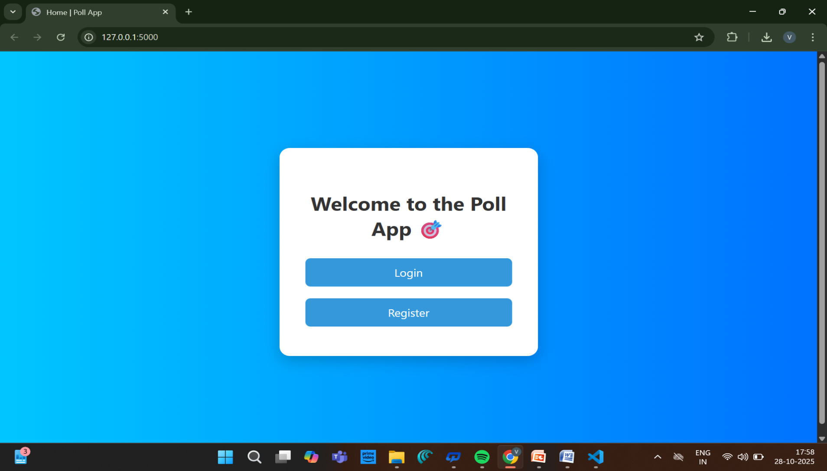
SAMLE OUTPUT

Slide 12
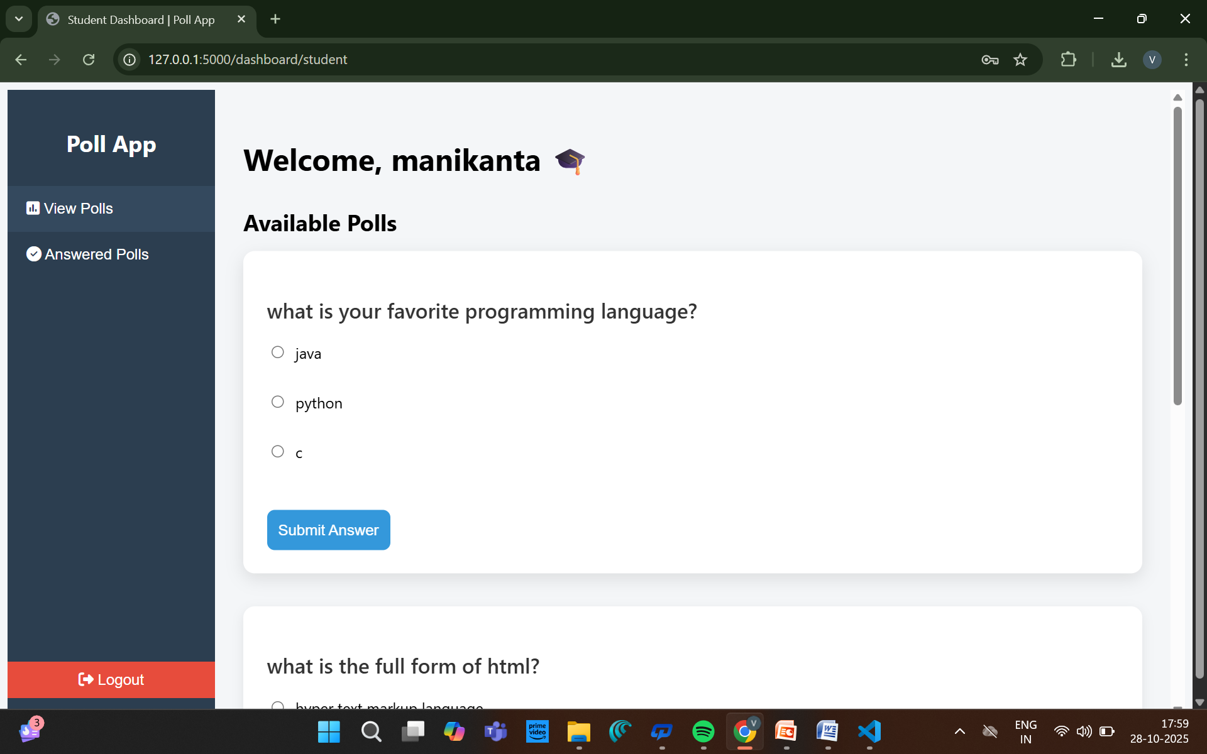
SAMPLE OUTPUT

Slide 13
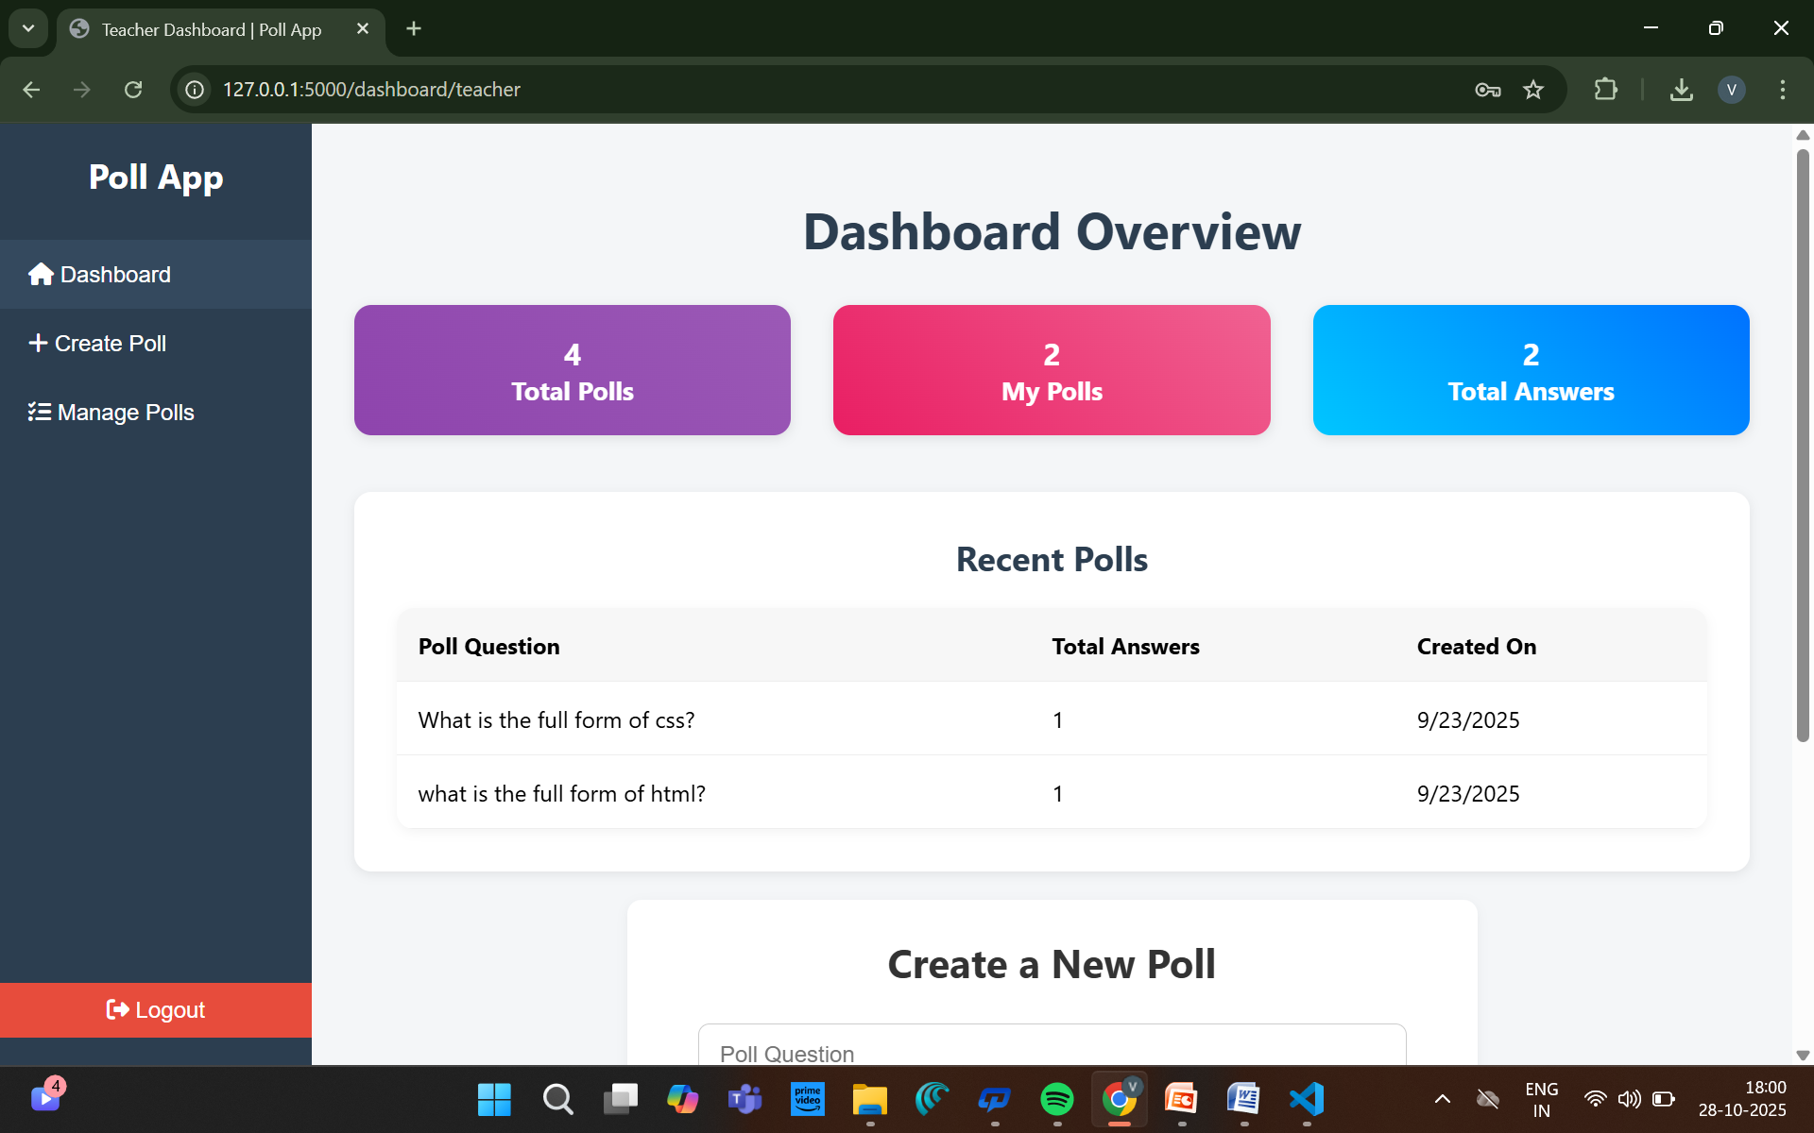
SAMPLE OUTPUT

Slide 14
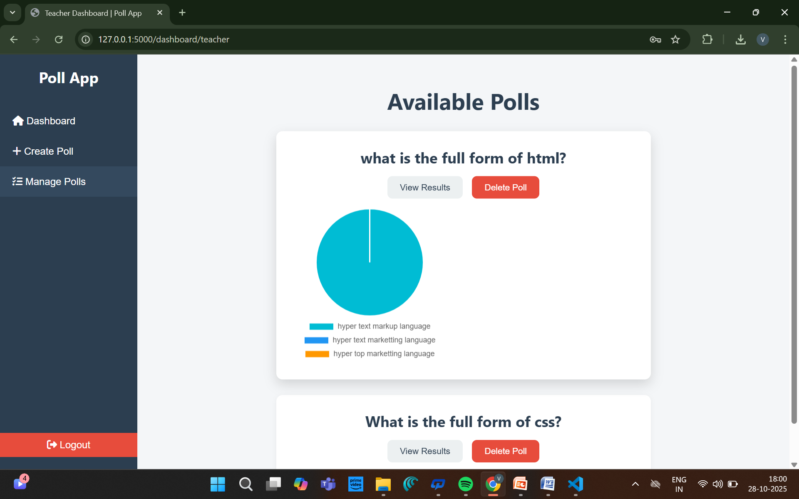
SAMPLE OUTPUT

Slide 15
CONCLUSION
The PollSystem successfully enhances classroom interaction by allowing teachers and students to engage through real-time polls. It provides a simple, secure, and user-friendly platform developed using Python Flask, HTML/CSS, and MySQL, with Firebase Authentication for security.
Usability testing showed that the system is easy to navigate, responsive, and effective in collecting instant feedback. By following Human-Computer Interaction (HCI) principles, PollSystem promotes active learning and better communication between teachers and students. Overall, it is a practical, scalable, and efficient solution for improving classroom engagement.

Slide 16
THANK YOU
We thank God, Our Department, Panel Members, Supportive Professors and all Technical and non Technical staff who helped us in our Project.

